Slide 1
Please complete the University Course Eval! https://tamu.aefis.net
Should take only 2-10 minutes, depending on whether you are willing to leave comments, too. I hope you will, and the more specific, the better.
My Promise: If you leave comments, I WILL READ them. Previous student comments have led me to change my course design in big and small ways.

Slide 2
Poverty & State Policy
Chapter 12A, Part 2
Tough Issue #1: Poverty (Part 2)
Dr. Dwight Roblyer

Slide 3
Learning Objectives
Describe the concerns of demographers connecting the changes in the makeup of Texas related to ethnicity, education quality, and economic potential.
Increase the standard policy tools used by states in varying degrees to address poverty among their residents.
Characterize the count and rate measures of poverty between 1960 and 2014. Explain the differences between the two measures over this same period.
Characterize the poverty rate by race and ethnicity, as well as by age group, over the same period from 1960-2014.
Describe in which regions of the US were the states with the highest and lowest rates of poverty in 2014.
Describe where Texas ranked in percent population in poverty among US states in 2014 and the state’s overall, deep, and child poverty rates in the same year.
Explain why poverty rates are often unexpectedly high in college towns.
Explain the correlations between welfare-related spending and poverty rates in the US states, as well as what this can mean about the effectiveness of poverty reduction efforts?

Slide 4
Learning Objectives
Describe how TANF worked in Texas in 2012: who was eligible, how much assistance they could receive. Compare this to neighboring states that border Texas.
Explain how TANF functions as a federal block grant and where and why Texas chooses to allocate and not allocate its TANF funds. Discuss how Texas compares to other states and the recent trends in Texas TANF spending.
Explain how inflation has affected TANF block grants since 1997, when they started.
Characterize how families on TANF or TANF and SNAP were faring as %s of the federal poverty level in Texas and other regions of the US.
Describe key questions that are important to consider when evaluating current or future poverty-reduction policies.
Describe the various influences that can affect our attitudes about social-safety-net policies.
List actions that individuals can take to become better informed about poverty and its impact in their state and locality.

Slide 5
Demographers are also forewarning about the future state economy!
Steve Murdoch’s newest book: Changing Texas
Panelist in Demography & Healthcare extra-credit option
Article about the book is source in Homework #12a
We already have learned that Texas’ population is increasingly more Hispanic and less white
He points out that this is accelerating rapidly: Hispanics will account for 70% of increase over next 25 years, largely due to higher birthrate
The problem is that Hispanic population is less wealthy and less educated than whites
So as Texas grows it will also become poorer, less educated, and less prosperous unless we change our policies
https://www.texastribune.org/2014/01/30/study-half-texas-households-are-crisis-poverty/

Slide 6
How Can Governments Decrease Poverty Levels?
All states say they want this to happen, but approach the problem with varying vigor
Poverty was decreasing until 2000, but has increased substantially since then
Also, gap is widening between those in “top 10%” income bracket and the rest of us
States use various, standard policy ingredients, each using its own “recipe”:
Boost welfare programs
Increase wages
Increase education opportunities
Provide basic healthcare
Notes:
Poverty decreased until 2000 and increased since then. The gap between the income and wealth of the top 10% in income and others has also increased at an unprecedented rate.

Slide 7
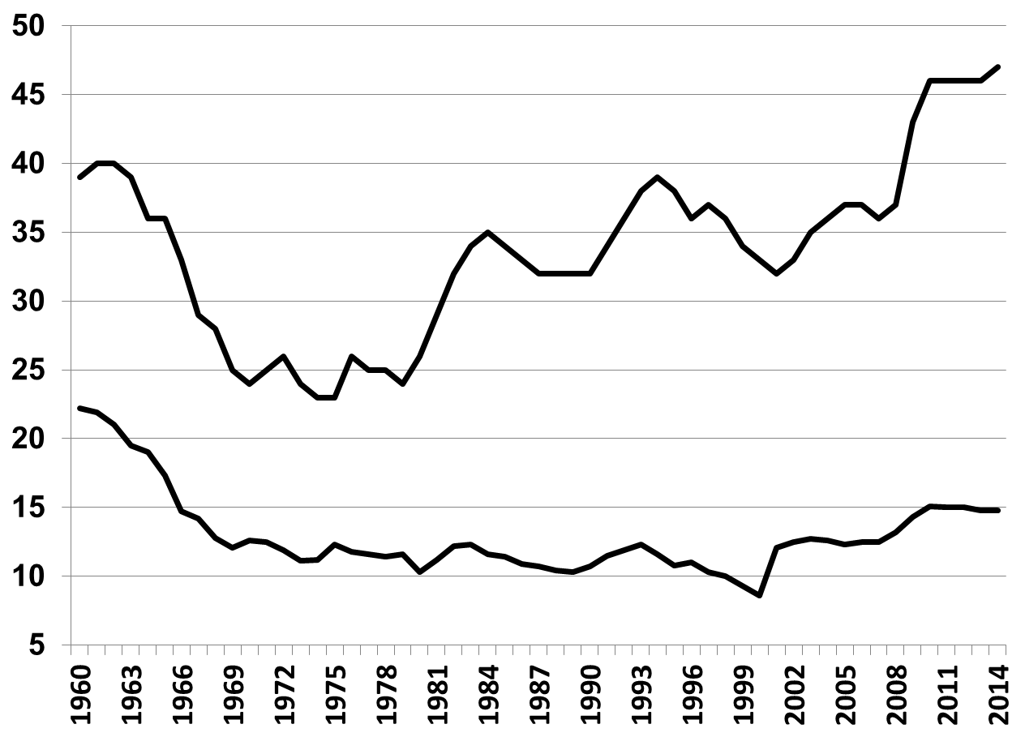
Poverty 1960-2014
(Counting all individuals at or below federal poverty line that year, along with their dependents)
Millions in poverty
What drives this difference?
Percent population in poverty

Slide 8
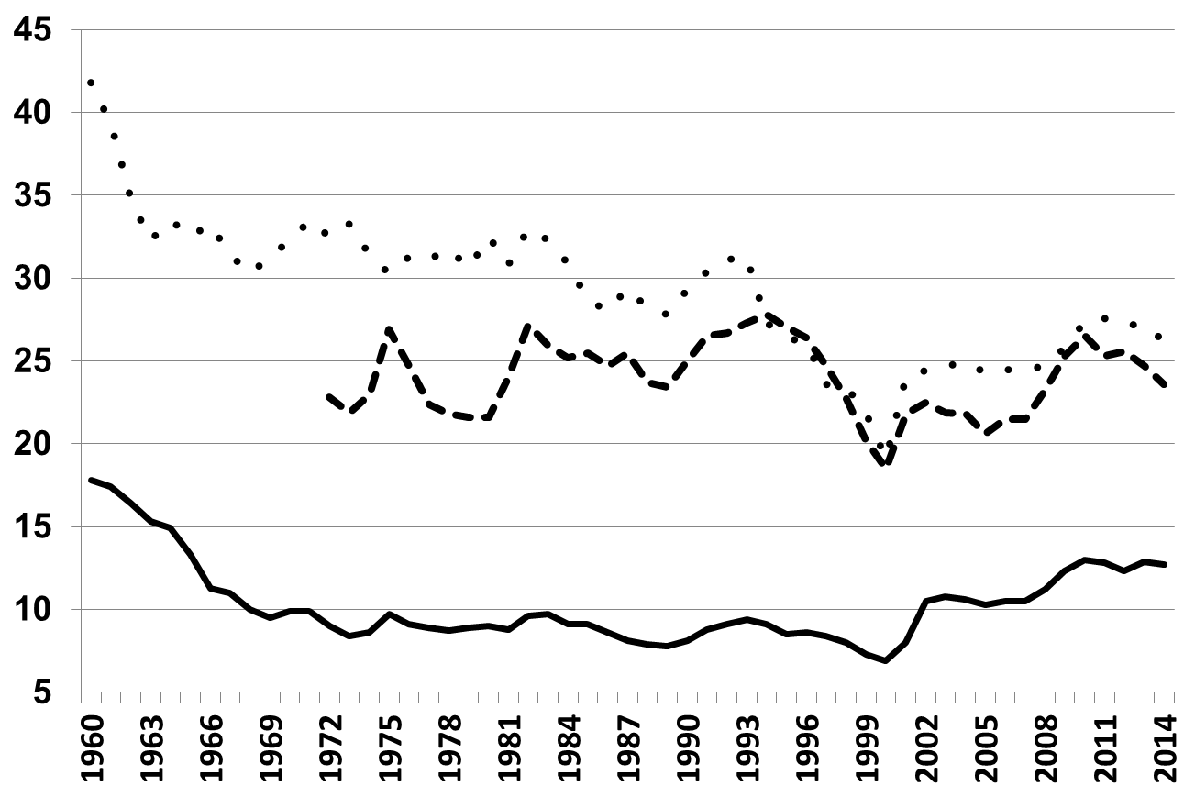
Poverty by Race 1960-2014
Poverty is not color-blind: minorities have highest numbers,
but whites are still represented, and increasingly so since 2000…
African American
Percent of each racial group in poverty
Hispanic
What happened?
Anglo

Slide 9
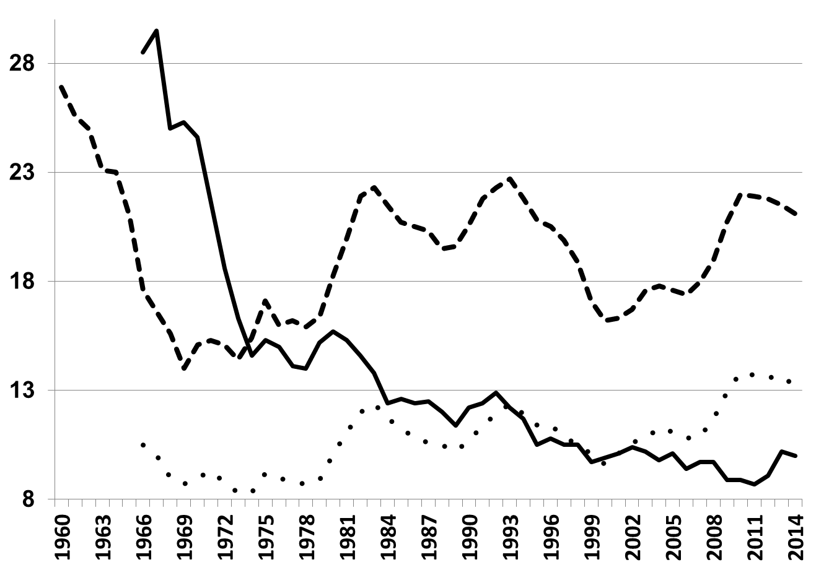
Poverty by Age 1960-2014
…Could this change a person’s perspective about poverty and what the government ought to do?
65 and older
Under 18
Percent of age group in poverty
18 to 64

Slide 10
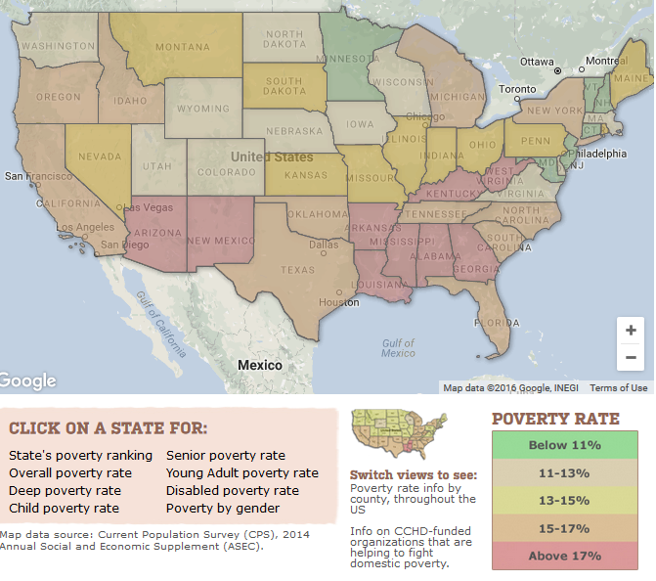
Texas’ poverty rate of 15.9% ranked it 39th in the U.S. in 2014
http://www.povertyusa.org/data/2014

Slide 11
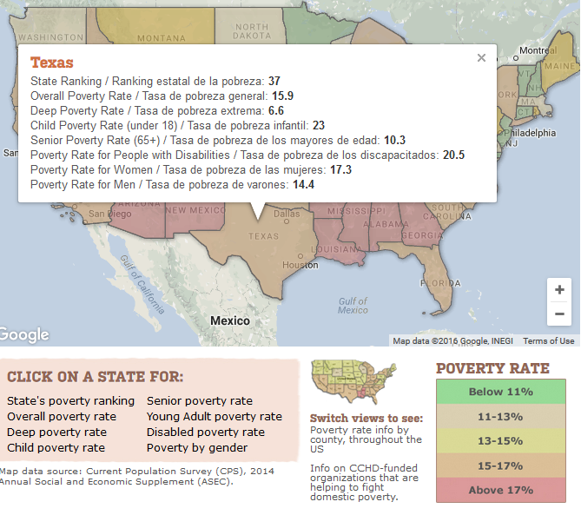
Poverty within Texas affected which two groups of Texans the most in 2014?
2018 Overall Poverty Rate in Texas is 15.5%
http://www.povertyusa.org/data/2014

Slide 12
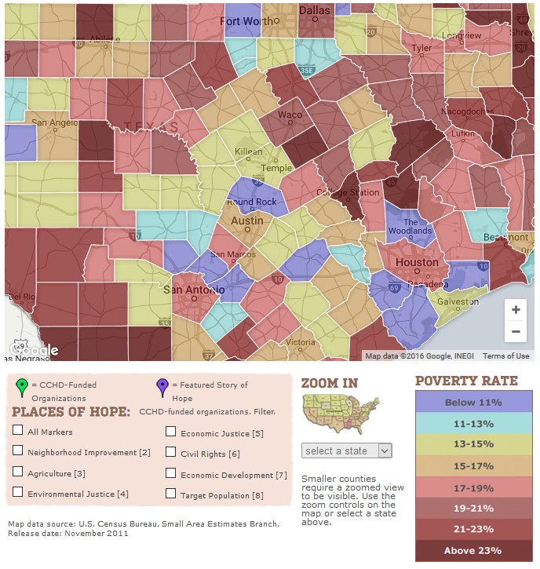
What was the Poverty Rate for Brazos County in 2014?
Poverty rates are usually inflated in university towns. Why?
http://www.povertyusa.org/the-state-of-poverty/poverty-map-county/
Notes:
It is because of a quirk in how poverty is measured. Income level is the only measurement that matters. So a struggling parent of 2 with an income of $18K per year is considered impoverished, but so is a college student with and annual income of $6K. Someone looking at those two individuals, however, would say that the college student probably shouldn’t count in an overall poverty population count because their condition is temporary, etc. Doesn’t matter to the Census Bureau—they look strictly at income and family size. This is why large universities can drive up the “poverty rates” in their local areas—it’s the “poor college students”.

Slide 13
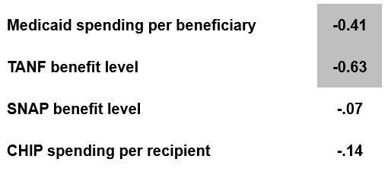

Does Welfare Reduce Poverty? Nationwide Correlations Between Poverty and Public Assistance Spending Per Recipient (2014)
Data regularly show a strong correlation, but politicians argue about causality
Why?
Notes:
HS completion -.82
College completion -.65

Slide 14
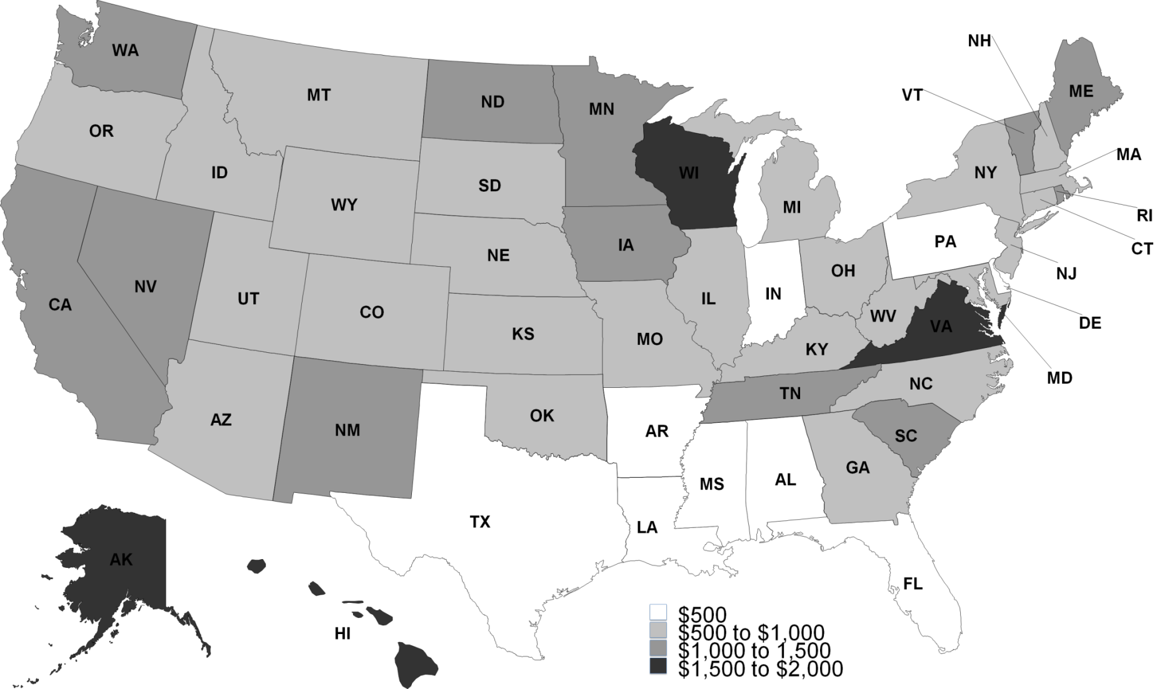
2012 Maximum Monthly Income for a Family of Three to Qualify for TANF Benefits (Temporary Assistance for Needy Families)
What does this tell us about Texas “welfare” policy then?
WI
VA
$401
AK
Notes:
Texas $401

Slide 15
2012 Maximum Monthly Income for a Family of Three to Qualify for TANF Benefits (Temporary Assistance for Needy Families)
What does this tell us about Texas “welfare” policy then?
WI
This is the equivalent of working 16 hours each week at minimum wage, while supporting 3 other family members….
VA
$401
AK
Notes:
Texas $401

Slide 16
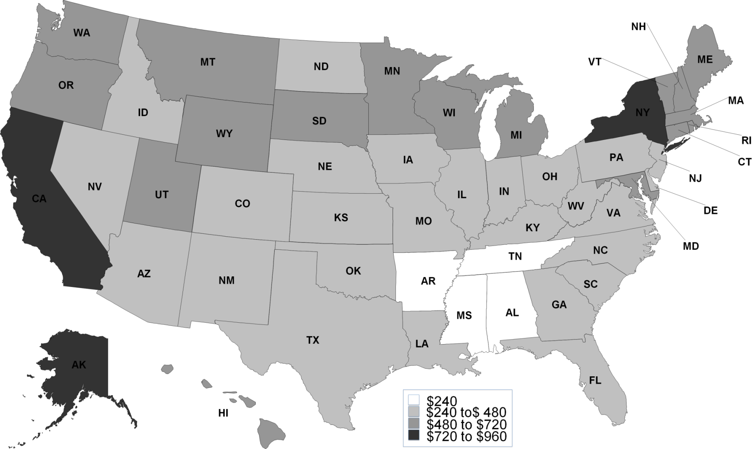
2012 Maximum Monthly TANF Benefit for a Family of Three with No Income
What else does this tell us about Texas “welfare” policy then?
NY
CA
AK
$249
Notes:
Texas $249

Slide 17
How Texas TANF Funds are Used
TANF is a federal block grant, permitting states wide latitude in how they use the funds
Each state required to also “chip in” a required amount—for Texas that is around $400M
Texas uses TANF funds extensively to fund programs that improve welfare of children in poverty
Early childhood, foster care, etc.
Texas sharply minimizes cash assistance to adults
Helps explain very tight restrictions and low benefits for Texans
Reflects Texas’ “pull yourselves up by your own bootstraps” approach
Does it matter to you how “welfare” funds are spent in your state? Why?
Notes:
http://www.urban.org/publications/412635.html
State Approaches to the TANF Block Grant: Welfare Is Not What You Think It Is
Heather Hahn, Olivia Golden, Alexandra Stanczyk
http://www.hhsc.state.tx.us/reports/2011/TANF-StatePlan-102010.pdf
Urban Institute
MOE is Maintenance of Effort; states must spend 75% of what they previously spent on AFDC

Slide 18
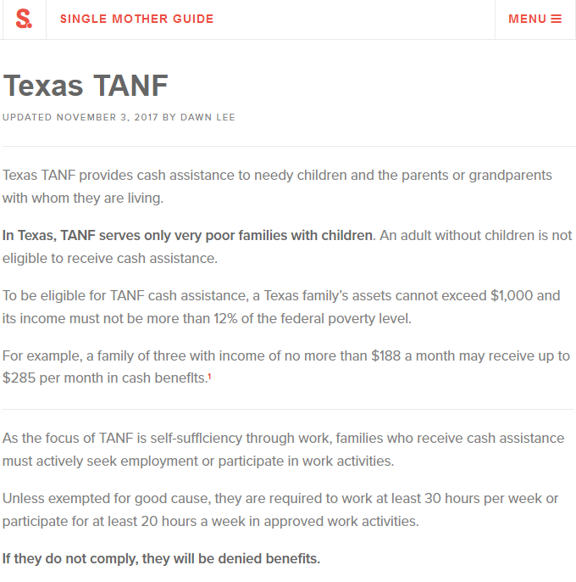
https://singlemotherguide.com/texas-tanf/

Slide 19
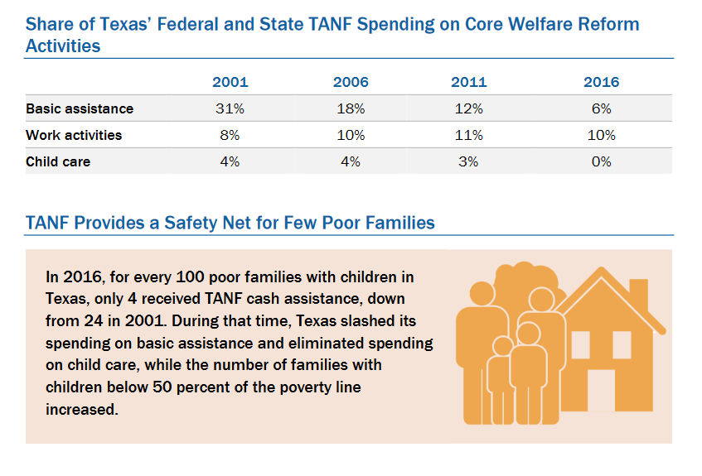
Texas ranked 51st in 2016 for spending on “core” TANF activities
https://www.cbpp.org/sites/default/files/atoms/files/tanf_spending_tx.pdf

Slide 20
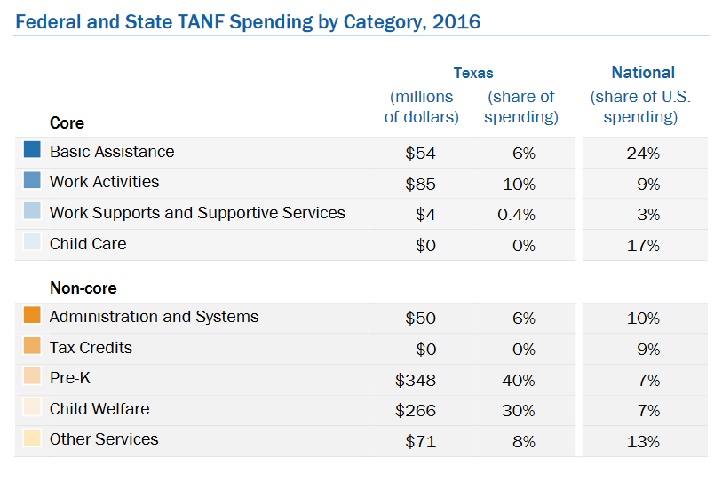
…and this is where Texas spends the bulk of TANF funds
https://www.cbpp.org/sites/default/files/atoms/files/tanf_spending_tx.pdf

Slide 21
…and this is where Texas spends the bulk of TANF funds
…and on top of all of that
The annual federal TANF block grant has been frozen since its creation and lost more than a third of its value between 1997 and 2016 due to inflation
https://www.cbpp.org/sites/default/files/atoms/files/tanf_spending_tx.pdf

Slide 22
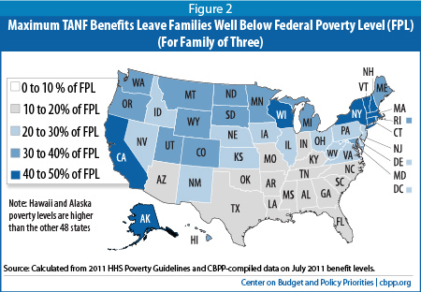
…But it’s not just Texas!
http://www.cbpp.org/cms/?fa=view&id=3625

Slide 23
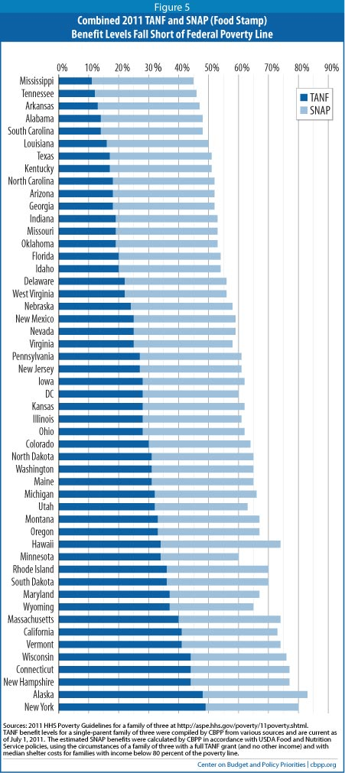
Does the picture change when TANF and SNAP benefits are considered together?
Remember:
The reasonableness of the Poverty Line as a measure of minimum expenses is highly questionable
TEXAS
http://www.cbpp.org/cms/?fa=view&id=3625

Slide 24
How to evaluate old programs or new proposals to “fix” poverty
How much may states adjust how benefits are distributed?
Who? (by age, gender, and income)
How? (monthly or annually, direct or indirect)
How livable is a family’s income level, after counting in all forms of assistance?
Which characteristics of that family would result in less assistance? Why?
How much reliance is placed on the private market?
Are there proper incentives for providers?
Are there safeguards for recipients and the public?
…this can be a good or bad!
Access detailed analyses from both conservative & liberal perspectives to get a fuller picture

Slide 25
When do politicians care more about social safety net policies?
Conservative vs. Liberal political ideologies may help explain overall positions based on differing ideas of the role of government
But what about other influences?
Religious beliefs
Moral convictions
Awareness of facts & associated math
Personal knowledge or involvement of individuals in need of the safety net
Understanding of our economic system

Slide 26
The single most-impacting thing you can do about poverty in your state…
…is start a friendly conversation with a low-income “stranger”
They are all around us: housekeepers, food servers, store clerks, etc.
Risk making friends with people who struggle to make a living
They’ll probably have no interest in asking for handouts from you
Listen to what they say about their life and how they understand the world around them
What are their hopes and plans? What about their family’s?
Are their efforts to move ahead succeeding? Why or why not?
Become involved in their lives, coming along side them to assist and to celebrate, as friends do
Evaluate your own assumptions about “those in poverty” against the realities you learn through these relationships
Ask yourself, what policy would make sense for my friends’ life situations?
Inspect other’s proposals using the 3-P framework, or other approach to critical analysis

Slide 27
Practice Problems …to begin mastering this material. Complete instructions are in the Module 1 resource, How to Use Practice Problems to Prepare for Exams.
Don’t forget to do the…

Slide 28
Please complete the University Course Eval! https://tamu.aefis.net
Should take only 2-10 minutes, depending on whether you are willing to leave comments, too. I hope you will, and the more specific, the better.
My Promise: If you leave comments, I WILL READ them. Previous student comments have led me to change my course design in big and small ways.

Slide 29
Making international law
A political process
Making international law
A political process

